Slide 1

University of Thessaly
Department of Primary Education
(with credit to Christina Karasavva and Vicky Zafeiropoulou for helping prepare this presentation)

Slide 2

The University of Thessaly
The University of Thessaly is the third largest university in Greece.
It was established in 1984.
Its administrative and academic centre is in the city of Volos.
There are five university campuses in:
  Volos
  Larissa
  Trikala
  Karditsa
  Lamia
The current (2021-2022) academic structure comprises 37 Departments, grouped in eight (8) Faculties.

Slide 3
The Department of Primary Education
University of Thessaly
Polytechnic
Sports Science & Nutrition
Humanities and Social Sciences
Medicine
Economics & Administration
Technology
Agricultural Sciences
Natural Sciences
Primary Education
Pre-School Education
Special Education
Language and Intercultural Studies
Archaeology and Social Anthropology
Culture, Creative media and Industries

Slide 4
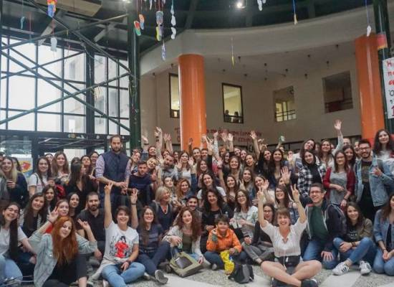
Our community
Approximately 1.000 undergraduate students
28 members of tenured faculty and teaching staff
Multiple adjuncts and teaching assistants

Slide 5
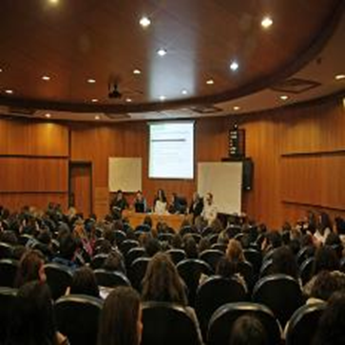
Undergraduate Studies
Typically, undergraduate studies last four years
The first two years tend to include more theoretical, core courses
The next two years tend to include more specialized courses, as well as didactics and the teaching practicum.

Slide 6
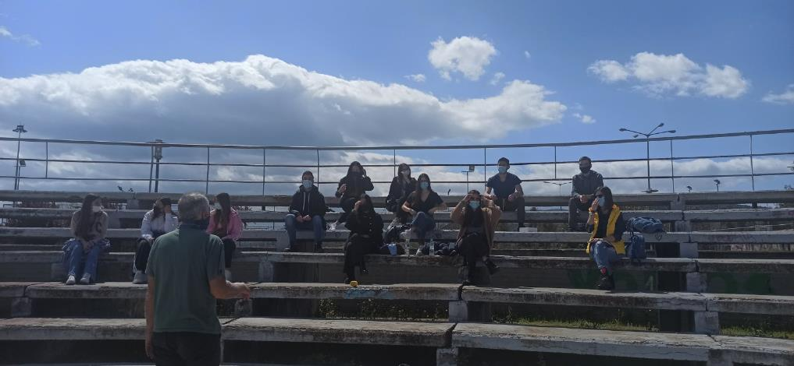
Learning at the Department of Primary Education
Courses: Either mandatory or optional*
Lessons: Take place in amphitheaters, classrooms or labs. Additional support is available in the form of tutorials/individual consultations with teaching staff.
Evaluation: Involves progress
tests, individual or collaborative
term papers, and final exams
Notes:
mandatory: should be attended by all students per semester in order to graduate, they are associated with general and basic knowledge
Optional: students can choose throughout a variety of lessons which are offered per semester, they are organised in thematic courses e.g. psychology, paedagogics.. and they should also be attended by all students in order to graduate, but they choose how many and what kind of them will attend per semester

Slide 7
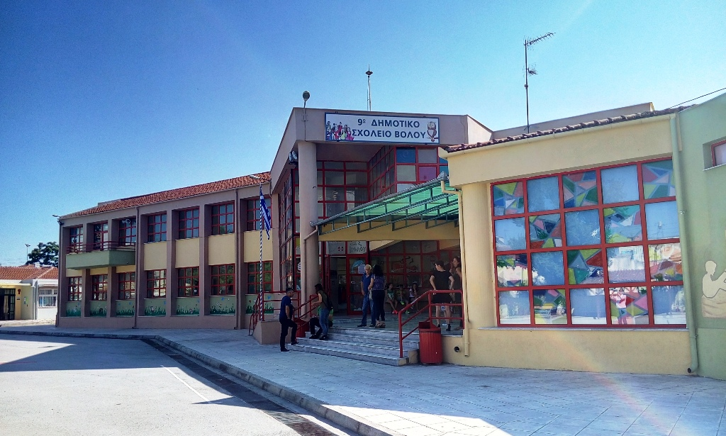
The practicum
The practicum is a hybrid form of gaining teaching experience, which includes university-based learning and a teaching placement.
It is divided into:
Group work facilitated by a member of faculty, which involves pre-teaching preparation and post-teaching reflections and feedback
Classroom observations and supervised teaching in local primary schools

Slide 8
Student support and pastoral care
→Dynamic presence in the society:
brings students in contact with the labor market through its Career Office
great deal of social activities and public lectures
cooperation between the University and the National Radio of Volos for the organization of radio broadcasts
Notes:
??? ΝΑ ΤΟ ΔΙΑΓΡΑΨΟΥΜΕ ???

Slide 9
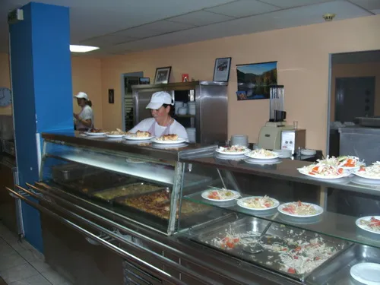
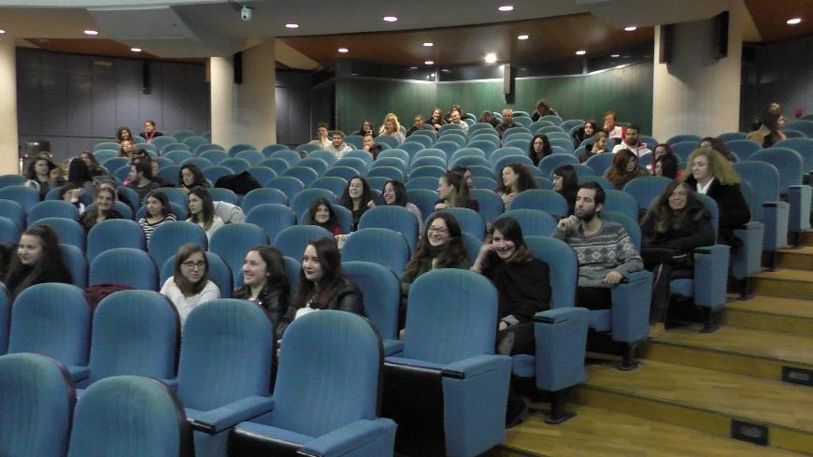
Student support and pastoral care
→Library: studying and borrowing any kind of books
→Dormitories: place for 40 students, only for first-year students, for one year, under certain conditions depending on the income
→Mensa: subsidized or free food for students (breakfast, lunch, diner), depending on the students’ family income
→Gym, theatrical & musical groups
Notes:
??? ΝΑ ΤΟ ΔΙΑΓΡΑΨΟΥΜΕ ???

Slide 10
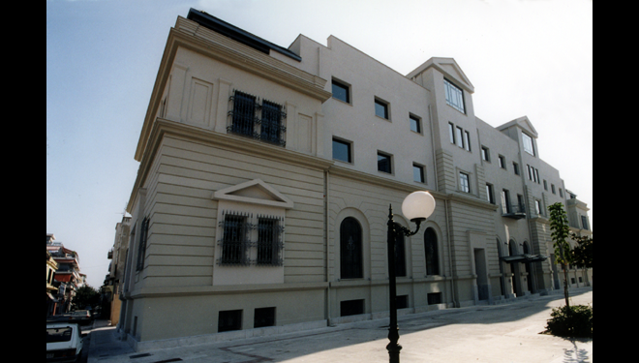
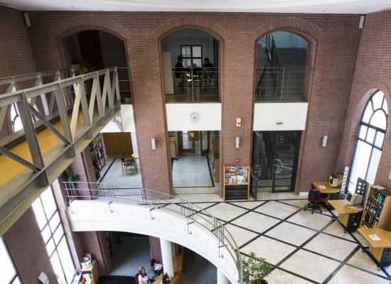
Library
Notes:
??? ΝΑ ΤΟ ΔΙΑΓΡΑΨΟΥΜΕ ???

Slide 11
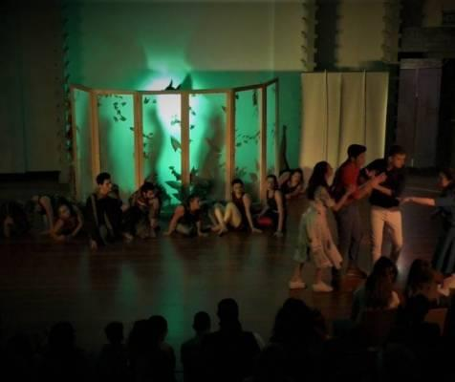
In addition
Students have a special card from the Uni which provides them with:
  Discounts in all means of public transport
  Special prices in cafeterias and restaurants
  Offers in other stores
  Free lunches at mensa
Groups of students organize:
  trips
  social events
  sports tournaments
  political activity
  cultural events (e.g., lectures, movie shows, concerts etc.)

Slide 12
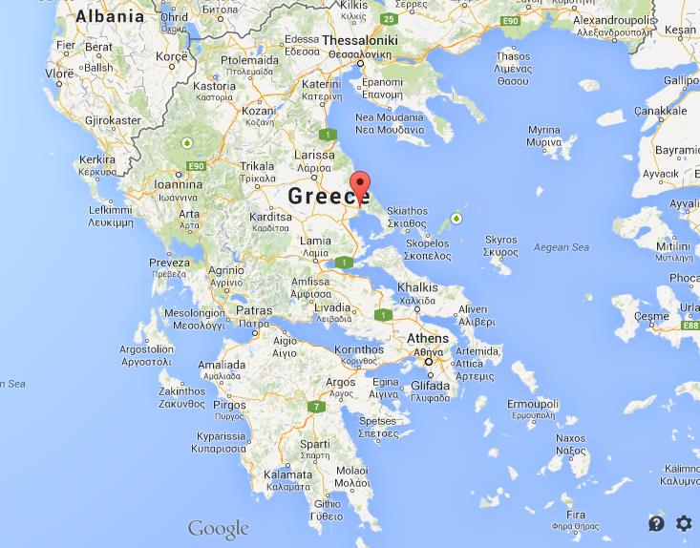
The city of Volos
Located in the central
Greece
Uniquely situated in the
Vicinity of sea and Mount
Pelion, with extraordinary
beaches and picturesque
villages

Slide 13
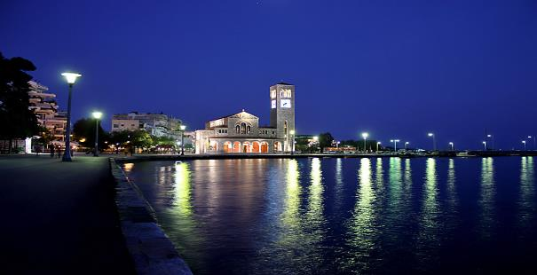
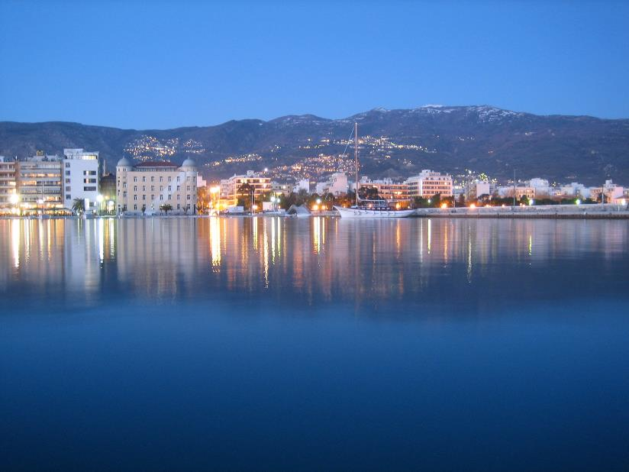
Volos
Saint Constantine

Slide 14
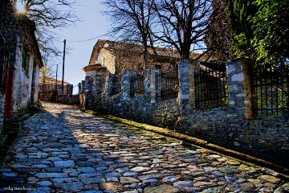
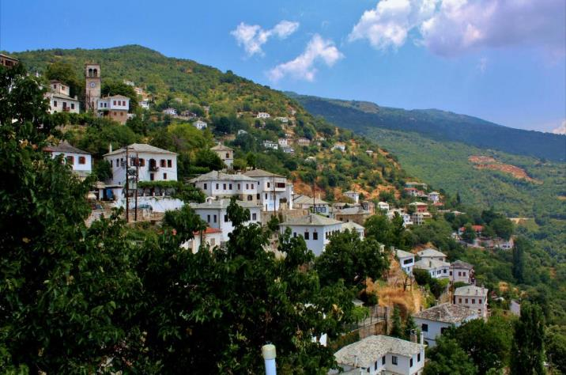
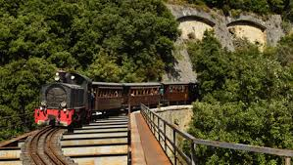
Mount Pelion
PORTARIA VILLAGE
MILIES

Slide 15
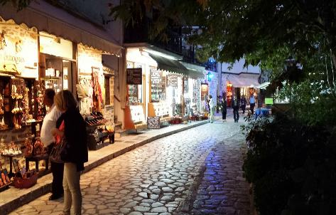
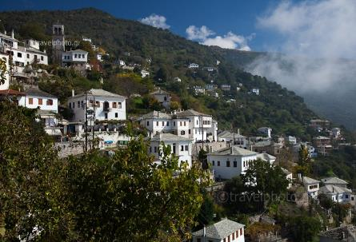
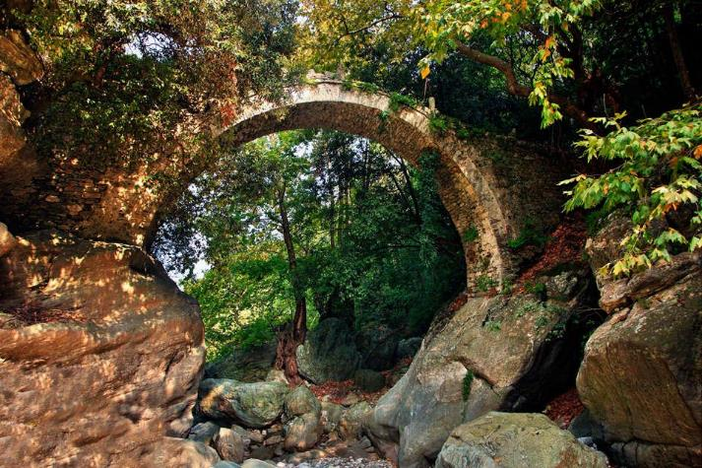
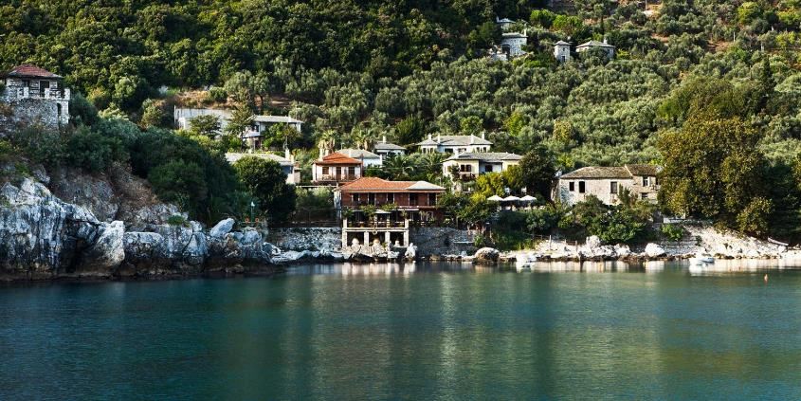
MAKRYNITSA
Damouchari

Slide 16
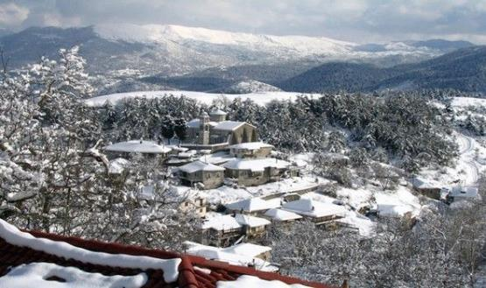
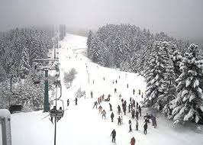
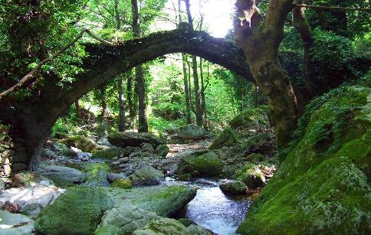
CHANIA
SKI CENTER
… ON THE ROAD TO PELION

Slide 17
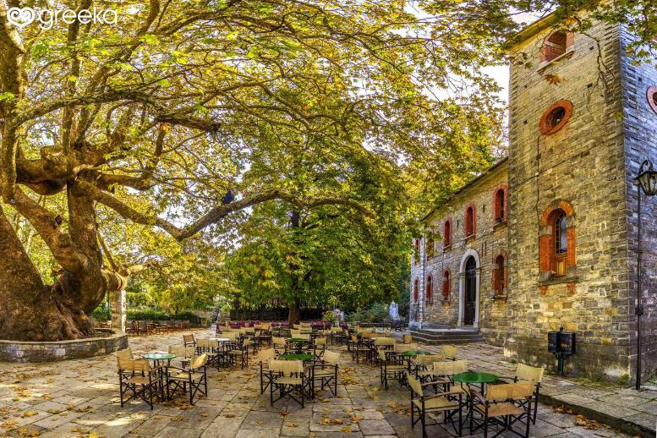
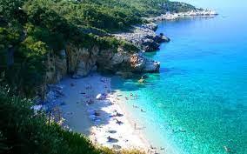
TSAGARADA VILLAGE
TSAGARADA BEACH

Slide 18
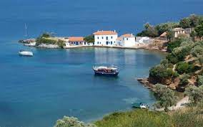
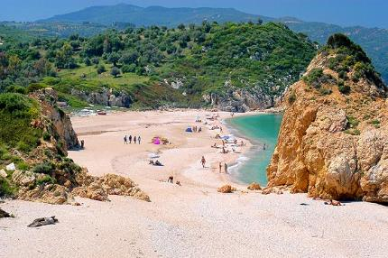
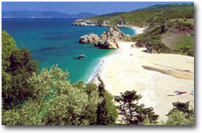
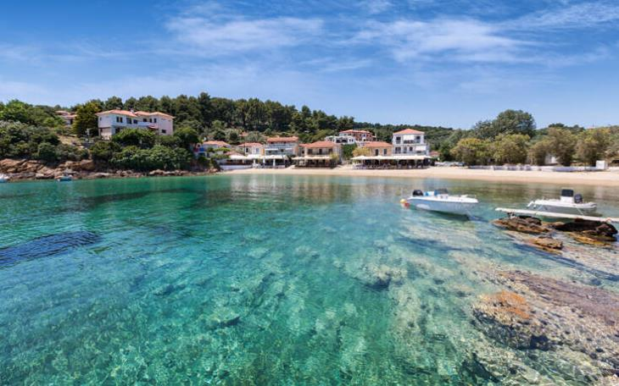
BEACHES

